Slide 1

Generative Models and VAE
Amirkabir University of Technology
(Tehran Polytechnic)
Computer Engineering Department
Radin Shayanfar, Erfan Ghasemi, Morteza Mirzaei, Mahan Ahmadvand
Supervisor: Dr. Ehsan Nazerfard

Slide 2
Outline
1
Introduction
3
Variational AutoEncoder
Generative model?
A generative variant of AutoEncoder
2
AutoEncoder
Unlabeled data encoder

Slide 3

Introduction
What is a generative model?
Generative models types and applications

Slide 4
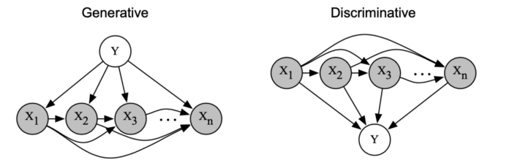

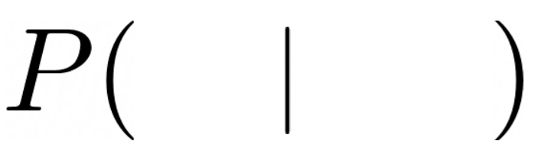
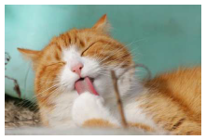


Discriminative Models
1
A class of supervised machine learning models
Make predictions by estimating conditional probability P(y|x)
Class
Features

Slide 5
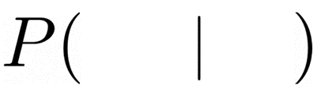
Generative Models
1
Given training data, generate new samples from same distribution
Want to learn P_{model}(X) similar to P_{data}(X)
Features
Class

Slide 6
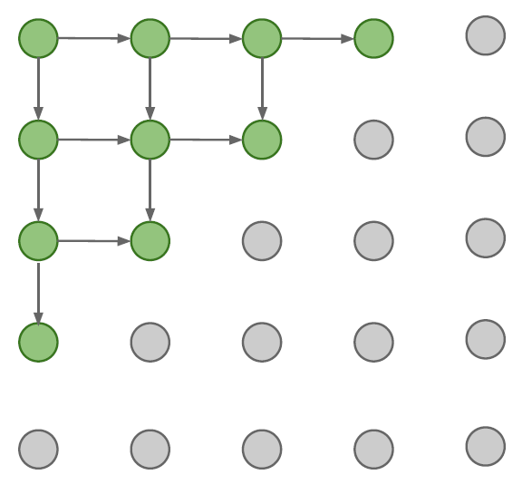
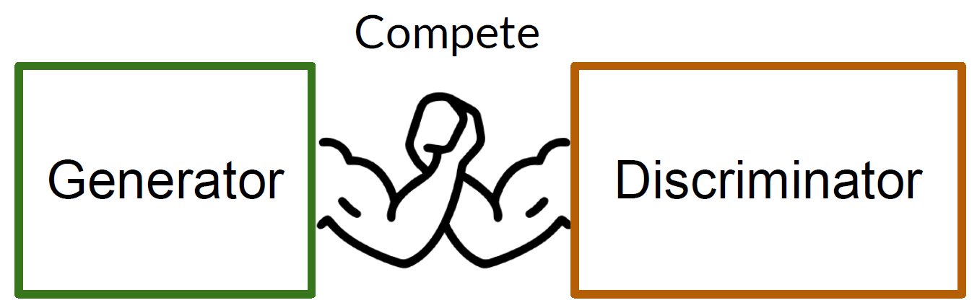
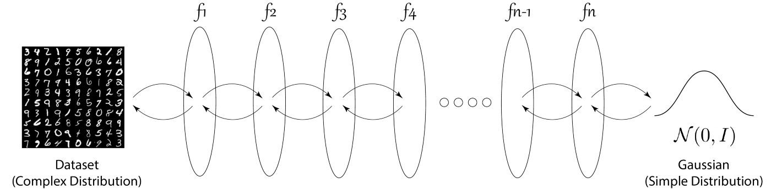
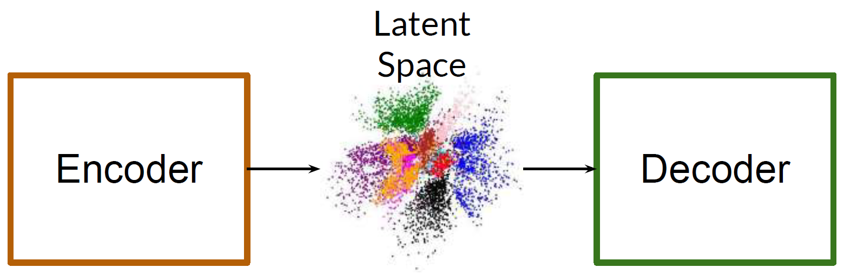
Types of Generative Models
1
GAN
PixelRNN
Normalizing Flow
VAE

Slide 7
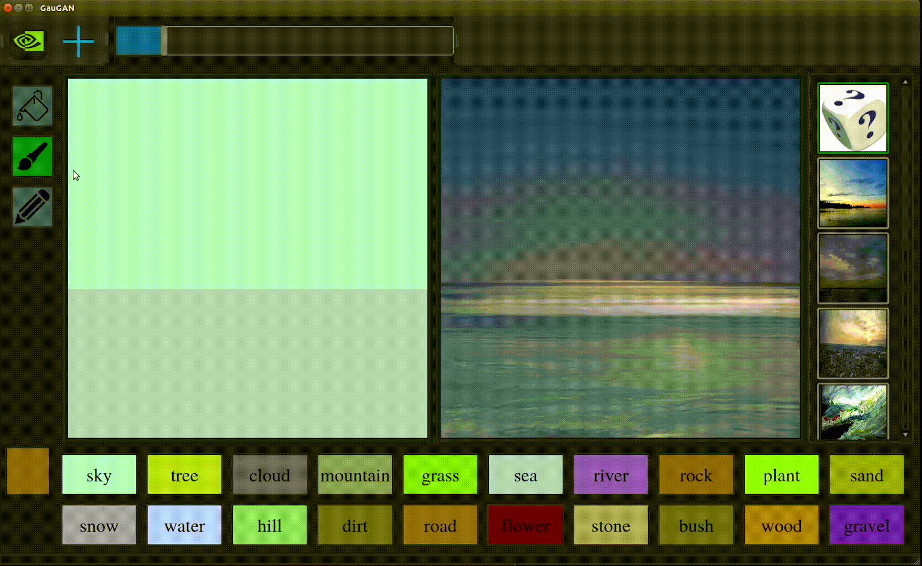
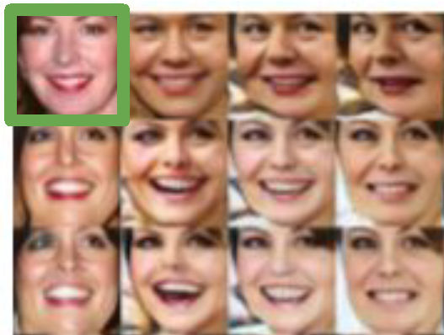
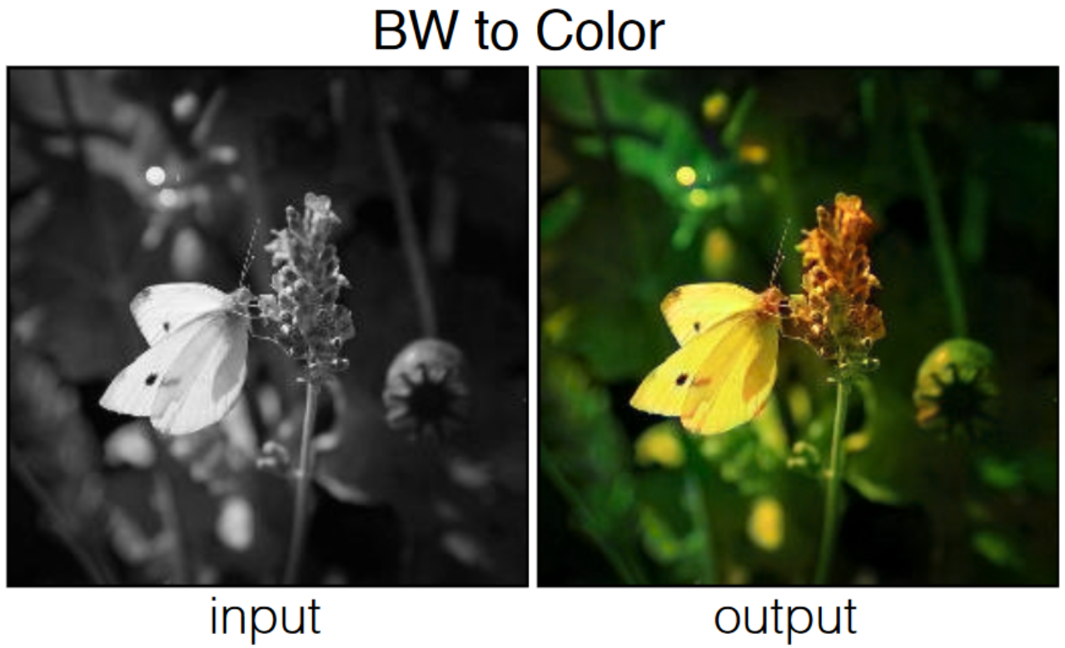
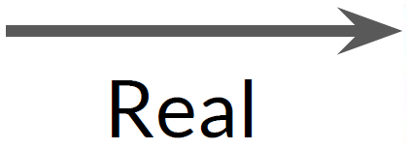
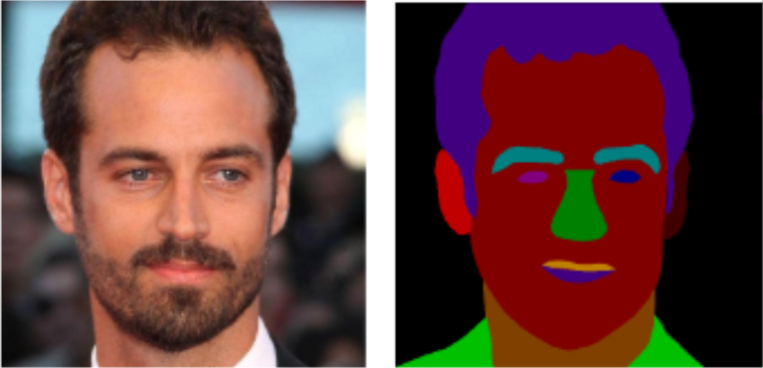
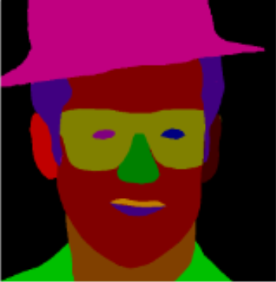
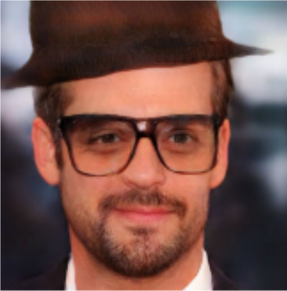
Applications of Generative Models
1
GauGAN
Image editing
Data augmentation
BW to color

Slide 8
Outline
1
Introduction
3
Variational AutoEncoder
Generative model?
A generative variant of AutoEncoder
2
AutoEncoder
Unlabeled data encoder

Slide 9
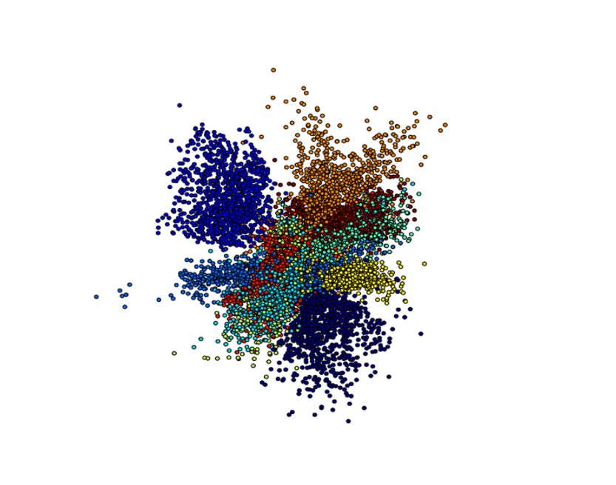
AutoEncoder
What is AutoEncoder and how does it work?
AutoEncoder architecture and applications

Slide 10
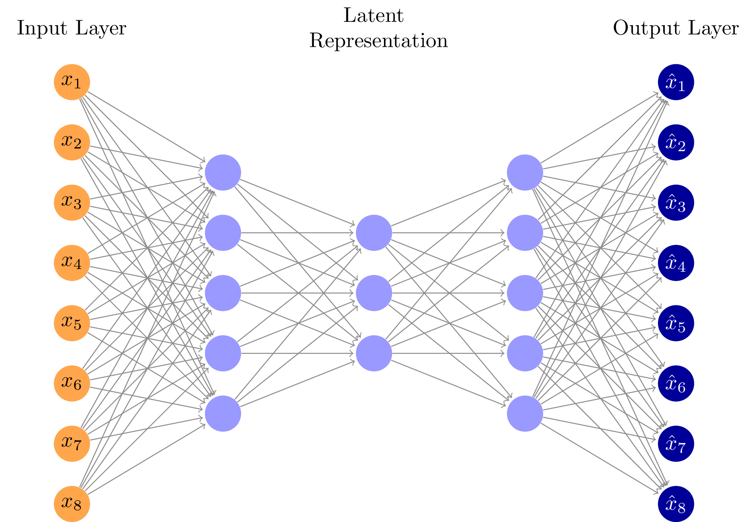

AutoEncoder Definition
2
Autoencoder is a type of artificial neural network
Learns efficient coding of unlabeled data
Learns a latent representation, typically for dimensionality reduction

Slide 11
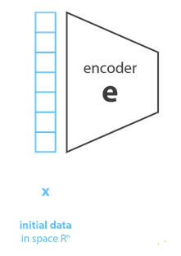
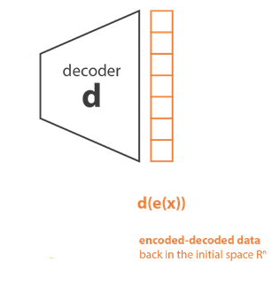

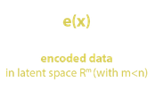
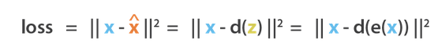
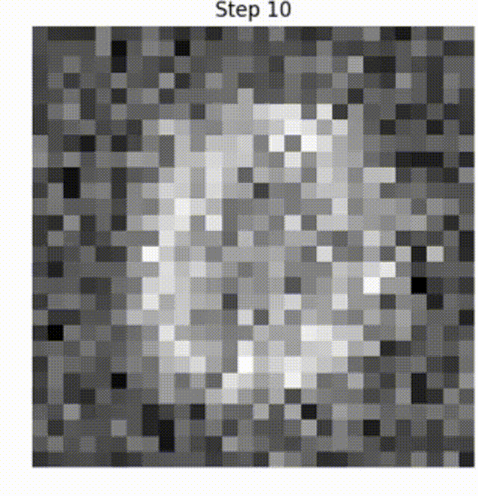
AutoEncoder Architecture
2
Encoder compresses the input into a latent space
Code stores the reduced representation of the input
Decoder is responsible for reassembling the code

Slide 12
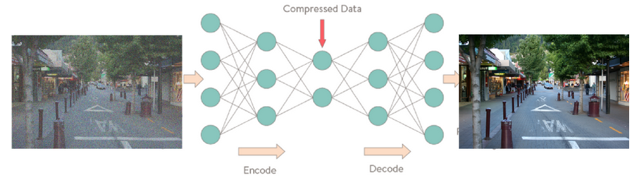
Applications of AutoEncoder
2
Reduction of dimensionality
Image denoising
Anomaly detection
Compression of data

Slide 13
Outline
1
Introduction
3
Variational AutoEncoder
Generative model?
A generative variant of AutoEncoder
2
AutoEncoder
Unlabeled data encoder

Slide 14
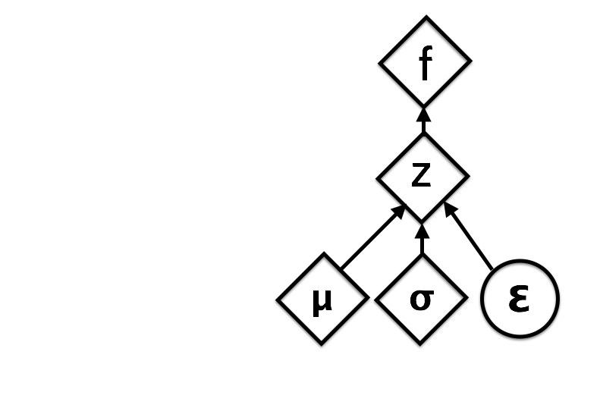
Variational AutoEncoder
Problems with AE as a generative model
VAE architecture

Slide 15
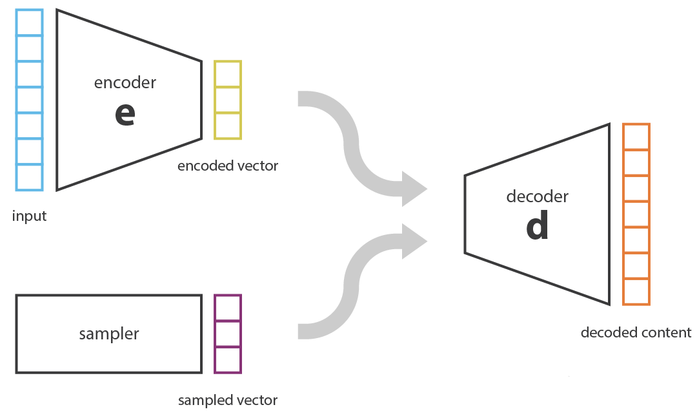
AE as a Generative Model
3
Samples from latent space
Decoder generates new output from sampled data

Slide 16
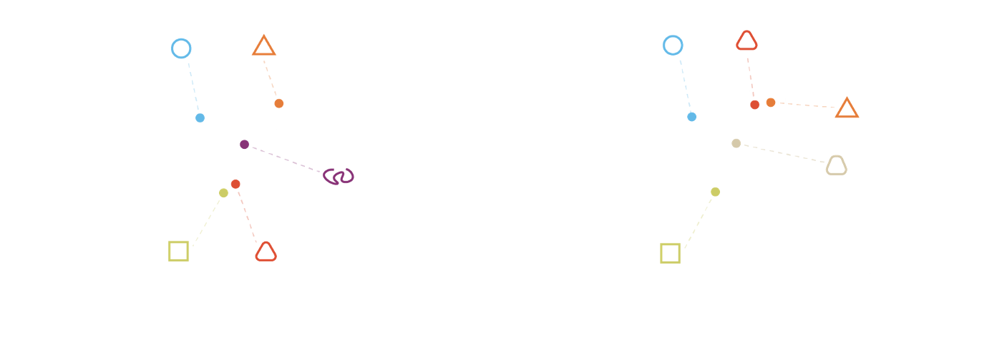
Problems of Generative AE
3
Latent space should be continuous and complete

Slide 17
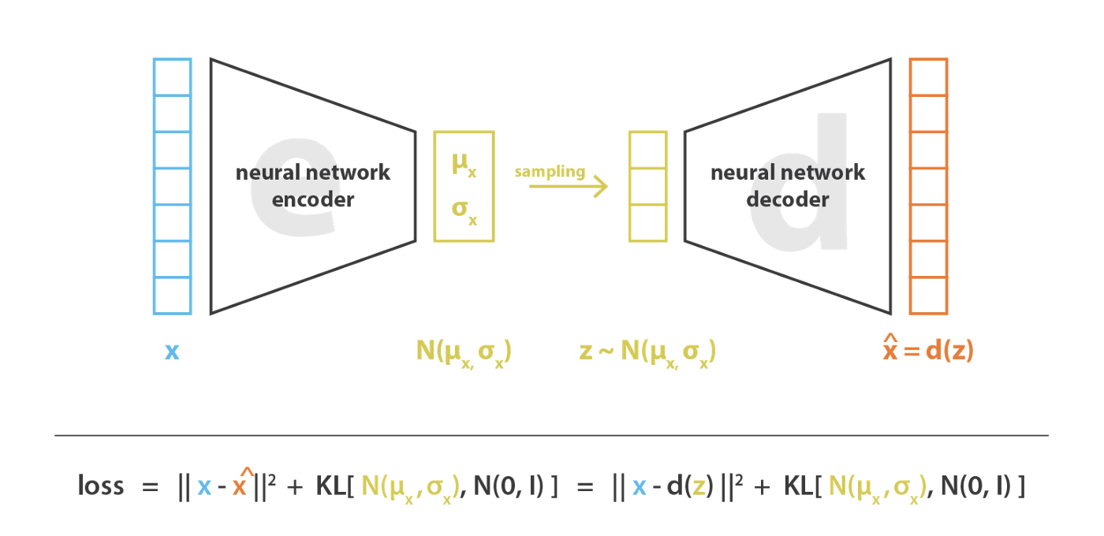
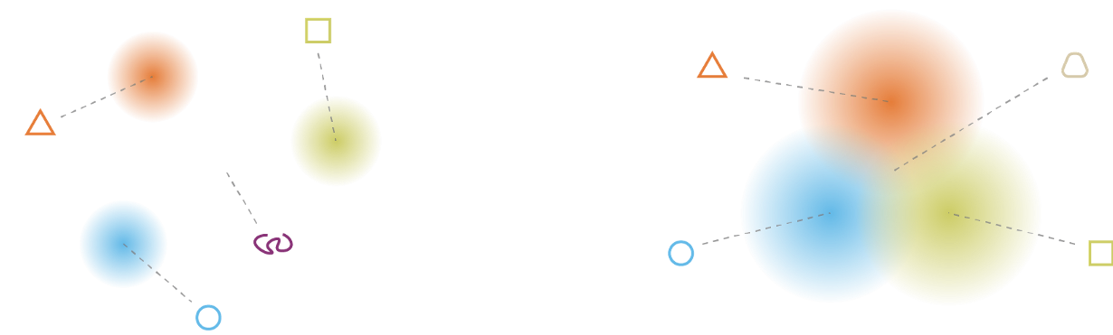
Variational AutoEncoder
3
Encodes input as a distribution
KL measures distance between distributions
Forces to regularize latent space

Slide 18
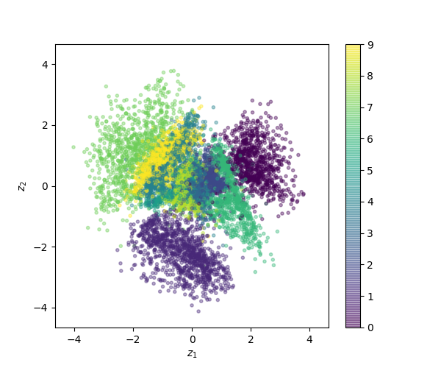
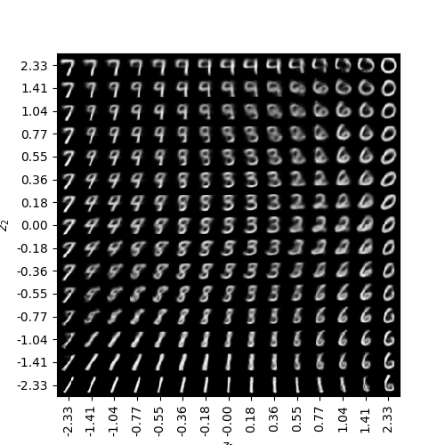
An Example of VAE
3
Trained on MNIST dataset
2D latent space
Smooth variation of digits

Slide 19
Thank You!
Any questions?
Amirkabir University of Technology
(Tehran Polytechnic)
Computer Engineering Department

